Slide 1
IDTE – Innovation Drive and Technology Expo
January 2019
Notes:
Brad/Joyce
Remind people to submit questions to everybody in the webex chat to make sure we can see them. We will take answer all questions at the end of the presentation.

Slide 2
Background
IDTE – Innovation Drive and Technology Expo is a five-day yearly in-house event showcasing advanced and research technologies to senior management. This event helps Ford Motor Company in pursuing the highly ranked technologies for production.
The registration is for 3 groups:
Evaluators: Ford upper management evaluating shown technologies
Presenters: Ford employees presenting the technologies to the evaluators
Suppliers: Outside companies/universities working with Ford teams on advanced and research projects
There is a need to develop a tool for the registrations using Ford Corporate approved technologies.
Notes:
Brad

Slide 3
Current Status
A tool has been partially developed by UofM graduates using Open Source technologies like PHP and MySQL.
Risks:
IT Budget, Team to complete the development and support the tool, Infrastructure to host the tool need to be established.
Technologies used may not be approved and validated with corporate architecture.
Notes:
Joyce, Khalil if any questions on time zone launches

Slide 4
Recommendations
The PD team has started to mimic the same functionality with in SharePoint 2016. The tool is still in the initial stages.
Advantages:
SharePoint is a corporate tool from Microsoft that has been used with in Ford for more than 6 years.
Digital Worker team has expertise and can provide training and help resolve issues. The maintenance of the SharePoint sites are done centrally by the Digital Worker team.
There is no cost involved as SharePoint is a corporate tool.
Tool is easy to learn and self help is available.
PD team can help customize the solution for the first phase to kick start the development.
Potential Risks:
The PD team is working with the DW team to find out if SharePoint can be provided for external to Ford with confidentiality and security.
Notes:
Joyce, Khalil if any questions on time zone launches

Slide 5
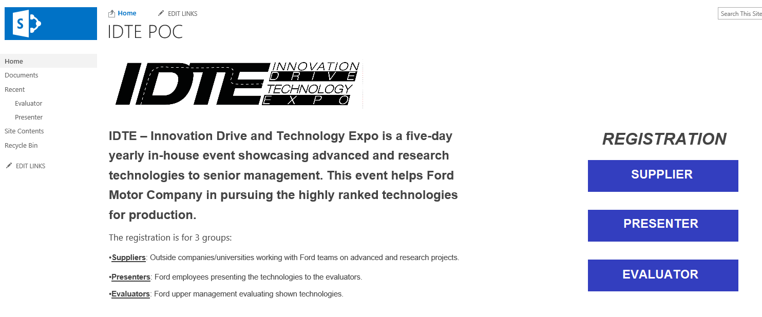
Screen Shot of the SharePoint POC
https://it1.spt.ford.com/sites/PDAM/IDTE/SitePages/Home.aspx

Slide 6
Thank You

